Slide 1
Membership of ETSI
Part 1 of 2

Slide 2






Who can become an ETSI Member?
Any organisation that respects the Purpose and Scope of ETSI activities (Articles 2 and 3 of the ETSI statutes)
Legal Entities (association, company, organisation or public authority) which commit themselves to:
    comply with the ETSI Directives and other decisions taken by the General Assembly,
    contribute to the work,
    make use of the standards produced to the extent practicable,
    support those standards for use as the basis for world standards and recommendations,
    pay the member contribution.

Slide 3
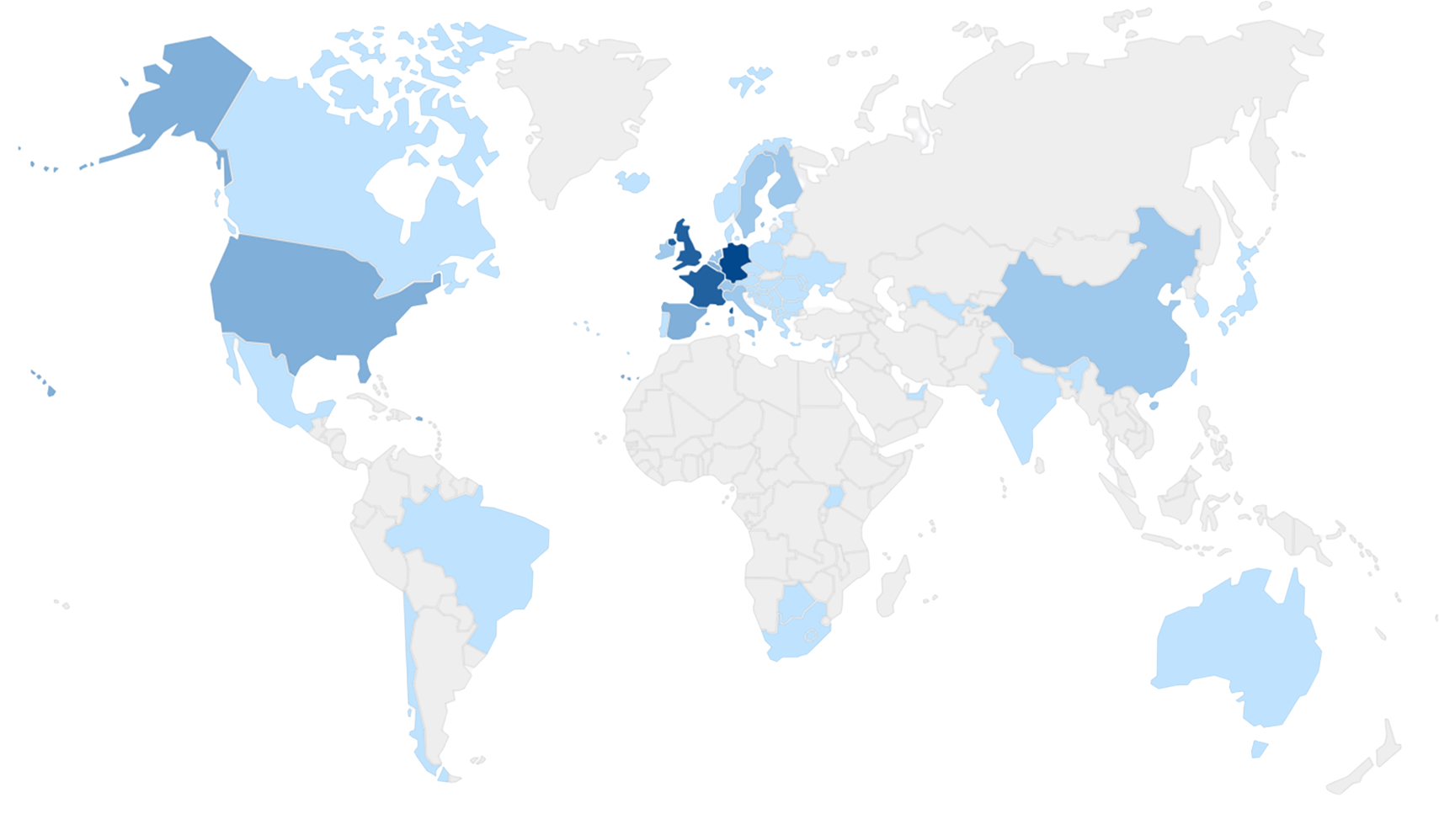
Who are ETSI’s Members?
Full membership list
  http://www.etsi.org/membership/current-members (public list)
  AND
  https://portal.etsi.org/Portal_IntegrateAppli_Sec/QueryForm2.asp
  (details available for existing members)
ETSI also has 2 Counsellors
  Representatives from the European Commission.
  Representatives from the EFTA Secretariat.

Slide 4

Types of status
Full Member
  Established in the geographical area of Europe (46 countries members of CEPT).
  Full member status may be obtained by a legal person, be it an association, a company, a grouping, an organisation or a public authority, which is established in a country falling within the geographical area of CEPT.
Associate Member
  Outside the CEPT.
  Associate member status may be obtained by a legal person not eligible for Full membership.
Observer Member (there are very few of this type of status)
  Entitled to be a member but not wishing to participate in ETSI’s technical work (GA attendance only).

Slide 5




Membership by type of status
~ 950 Members over 6 continents:
* https://www.cept.org/cept/membership-and-observers
± 82 %
Full Members.
Legal entity established in the geographical area of Europe.
(46 countries members of the CEPT*)
± 18 % Associate Members.
Legal entity established outside of the geographical area of Europe.
< 1 %
Observer Members.
Not wishing to participate in ETSI’s technical work.

Slide 6

Differences for Full or Associate Members
ONLY Full Members:
May participate in determining the General Assembly (GA) quorum.
May request the convening of an extraordinary GA meeting.
May be grouped in National Delegations during GA meetings.
May be appointed as Head of National Delegation.
May be appointed as a Board member.

Slide 7
Both Full or Associate Members
Participation and Voting Rights in ETSI Bodies:
May participate and vote in the General Assembly (GA), including nominating candidates for GA Chair and Vice-Chair, casting proxy votes (up to 3), and voting in Weighted Individual Voting for Board elections.
May participate and vote in Special Committees (SCs), Technical Committees (TCs), ETSI Projects (EPs), ETSI Partnership Projects (EPPs), Industry Specification Groups (ISGs) and Software Development Groups (SDGs).
May vote for the adoption of ETSI Standards (ESs) and ETSI Guides (EGs), and vote on all matters within Technical Groups (TGs).
Board-Related Rights:
May nominate candidates for the ETSI Board.
May vote in Board elections according to individual weight, including splitting votes among candidates.
May be invited by the Board Chair to attend specific Board meetings.
Leadership and Support Roles:
May support new Work Item proposals and the creation of new Technical Groups.
May serve as Technical Group Chair/Vice-Chair, Working Group Chair, or Rapporteur.
May act as the initial Convenor of a new ISG during its setup phase.

Slide 8
Categories of Member
Administrations contribute according to the GDP of their country, usually the department leading on electronic communications and digital technical standards for the government.
Other Governmental Bodies - Central government departments, local government departments, public institutions, public authorities (agencies, corporations etc.) that function separately from the Administration member.
Network Operators (or associations of NOs).
Manufacturers (or associations of Manufacturers).
Service Providers (making use of an electronics communications network to provide services on a commercial basis or associations of SPs).
Consultancy Companies (entities that provide professional expertise in relation to electronic communications and related areas).
Users - making use of electronic communications and related areas) (or associations of Users).
Public Research Bodies.
Private Research Bodies.
Universities.
National Standards Organisations.
Others (anyone who doesn’t fit into the above but is able to comply with
ETSI Statutes and RoP).

Slide 9
Members by category in %

Slide 10
ETSI inclusiveness
The yearly contribution is designed to be accessible for:
  SMEs and Micro-Enterprises.
    SME and Micro-Enterprise as defined
    by the European Commission.
  Trade Associations and End User (consumer) Associations.
  Universities and Public Research Bodies.
  Other Governmental Bodies.
  National Standards Organisations.

Slide 11

Points to remember
Any organisation that respects the Purpose and Scope of ETSI activities may apply to become an ETSI Full or Associate member and may directly participate in the work of all the technical groups.
There are three types of member status.
  Full Member, Associate Member and Observer Member.
There are 12 different categories (see slide 8).
There are 3 different types in addition to the above (SME,
ME, Association).

Slide 12

THANK YOU
FOR YOUR ATTENTION
Follow us on:

