Slide 1
How We Make Better Standards
Testing and Interoperability

Slide 2
ETSI and Interoperability
Interoperability is important
  We live in an interconnected world and interoperability is key to drive it forward
  Users benefit from increased choice from multiple manufacturers
  Manufacturers benefit from an increased market
Standardization enables interoperability
  Enabling interoperability in a multi-vendor, multi-network, multi-service environment
Interoperability is the red thread running through the entire ETSI standardization process
  Interoperability is addressed from the beginning
  Not something ‘bolted on’ at the end, it must be built-in

Slide 3

Standards Development - Three Best Practices
Technical Bodies
3GPP
AERO
ATTM
BRAN
DECT
eHEALTH
ERM
ESI
HF
INT
ITS
LI
SmartM2M
MTS
SET
STQ
TCCE
oneM2M
etc …
Application of good standards engineering principles, guidelines and techniques
SPECIFICATION
VALIDATION
Validation of standards as an active part of the development process.
Mainly through peer review and interoperability events
TESTING
Development of standardised test specifications for key technologies

Slide 4
ETSI Support for Interoperability
Technical Committee Methods for Testing and Specification (MTS)
  Standardised frameworks, methodologies, languages
    For protocol specification
    For testing
Centre for Testing and Interoperability (CTI)
  Direct support to ETSI Technical Bodies
  CTI experts can be attached to a standardization group and provide hands-on assistance

Slide 5

CTI expertise
Protocol Design
CTI
Standards Engineering based on methodology and best working practices
Training
Test Specifications
Validation Activities
Interoperability Events

Slide 6
CTI activities
Protocol Design and Specification
Application of best practice
3-Stage approach
Techniques such as:
UML, MSC, ASN.1, XML, openAPI, etc…
Training
Best Practices
Methodology
Languages
Implementation issues
Test Specification
Test Planning & Frameworks
Extraction of Requirements
Test Purposes
Test Descriptions
Abstract Test Suite (executable code)
Tool support
CTI
Standards Engineering based on methodology and best working practices
Training
Test Specifications
Validation Activities
Validation of Standards
Peer-review
Simulation by modelling
Interoperability events
Interoperability Events
Organizational &Technical
Logistics, website, press
Registration, NDA, promo
Test platform and IT
Monitoring, test results
Feedback to TC
Validation Activities
Interoperability Events

Slide 7
Interoperability must be built in!
Specification of minimum requirements to achieve interoperability, while leaving room for product differentiation
Unambiguous protocol specification
  Protocol engineering techniques
  Consistent and precise language use
  Naming conventions, editing rules
Testability must be built in
Where applicable use of standardized technical notations
  ASN.1, MSCs, SDL, UML, IDL, XML, etc.

Slide 8


Why Validate Standards?
Validation reveals problems/errors in standards
Provides an opportunity to correct errors in a controlled manner
  Decreases time to market
  Late fixes in the product cycle are more expensive than early ones
Validated standards give a higher chance of interoperable products
  Assurance that they provide the right functionality
  Gives manufacturers and operators confidence to implement and go to market
Time
Products mature from prototypes to commercial products
Interoperability Events
Prototyping
Modelling and Simulation
Peer Review
Development of Base Standards

Slide 9

Validation through Interop Events
ETSI Plugtests events
  Open to members and non-members
Aim is to validate standards
  Feedback (Change Requests) to relevant technical bodies
  A tool to develop and mature standards
But product testing and debugging are useful by-products
  Vendors validate their understanding of standards and their implementation
  Achieve in one week what would otherwise take months
Promote technology and community
  Develop new ideas, confirm existing ones

Slide 10
Series of IOP Events
Maturity of the Standard
Event 1
Event 2
...........
Event nn
Events

Slide 11
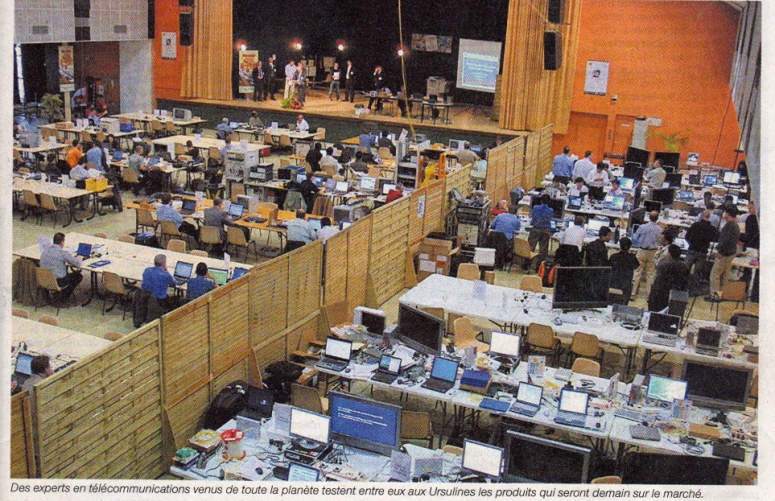
Plugtests™ can look like this…

Slide 12

… or this (Car2Car Interop)

Slide 13
Useful Links
Achieving Interoperability - The ETSI approach:
www.etsi.org/images/files/ETSIWhitePapers/IOP%20whitepaper%20Edition%203%20final.pdf
ETSI Approach to Interoperability and Testing
Guide to Writing World Class Standards
Interoperability Best Practices
CTI: www.etsi.org/about/how-we-work/testing-and-interoperability
Plugtests: www.etsi.org/about/what-we-do/plugtests
TTCN-3: https://ttcn-3.etsi.org
STF: portal.etsi.org/STF/STFs/Summary.aspx
Mail contact: CTI_support@etsi.org

Slide 14

THANK YOU
FOR YOUR ATTENTION
Follow us on:

