Slide 1
Standards and the EU Legal System
Presented by: Dr. Olia Kanevskaia

Slide 2
The link between law and standards
Main principle: laws are mandatory, standards are voluntary
Law are adopted in a legislative process, standards are developed in private, industry-driven processes
Voluntary nature of standards is recognised internationally:
  Example: WTO Agreement on Technical Barriers to Trade, Annex 1.2, Explanatory Note:
  […] For the purpose of this Agreement standards are defined as voluntary and technical regulations as mandatory documents […]
Nevertheless, standards can produce legal effects

Slide 3


New Legislative Framework
New Approach/New Legislative Framework (NLF) regulatory technique introduced in the 1980s, based on public-private partnership
Harmonized European Standards (hENs)
Essential Requirements for compliance with EU Legislation
EU Legislation
Presumption of conformity

Slide 4
Regulation 1025/2012: Main Legal Provisions
Definitions of Article 2 (1):
  ‘standard’ means a technical specification, adopted by a recognised standardisation body, for repeated or continuous application, with which compliance is not compulsory, and which is one of the following:
  (a) ‘international standard’ means a standard adopted by an international standardisation body;
  (b) ‘European standard’ means a standard adopted by a European standardisation organisation;
  (c) ‘harmonised standard’ means a European standard adopted on the basis of a request made by the Commission for the application of Union harmonisation legislation;
  (d) ‘national standard’ means a standard adopted by a national standardisation body
  European Standards Organizations (ESOs) produce many deliverables, but only harmonised standards grant presumption of conformity with EU legislation
Transparency obligations ESOs and National Standards Bodies (NSBs), for example:
  Publish annual work programme (Article 3)
  Ensure broad stakeholder participation
    Small and Medium-Size Enterprises (SMEs) (Article 6)
    Annex III organizations (Article 5(2)): societal stakeholders, including consumer and environmental organizations eligible for EU funding under Article 16 of Regulation 1025/2012.
Standstill obligation (Article 3(6)): NSBs may not publish or maintain national standards that conflict with hENs, even when they still need to be approved. Conflicting national standards must be withdrawn.
hENs are distributed through NSBs. ESOs and NSBs operational framework establishes further rules.

Slide 5
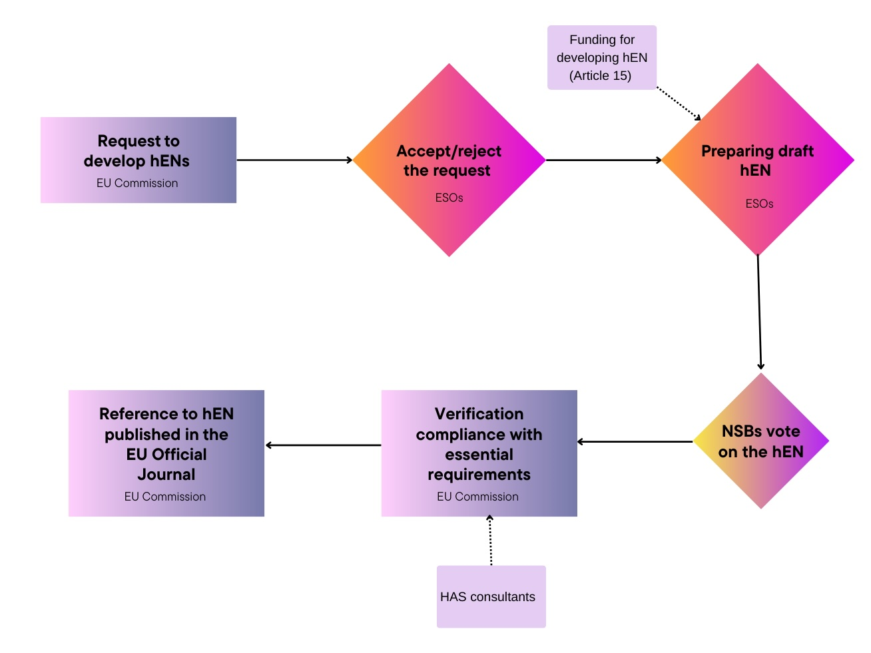
Main actors in EU standardization: Article 10 Regulation 1025/2012
EU Commission:
  Requests a hEN
  Verifies compliance of a hEN with the requirements of the request
  Publishes reference to a hEN in the OJEU
ESOs:
  Accept/deny a request for hENs
  Draft a hEN
NSBs:
  May participate in the technical work of ESOs
  Approve draft hENs
EU Member States:
  Lodge a formal objective if suspected that a hEN does not meet the essential requirements of EU legislation (Article 11)
  EU Commission then decides whether to publish or withdraw the OJEU reference to that hEN, and/or request a revision of that hEN

Slide 6
Legal effect of voluntary hENs
Case law of the European Court of Justice:
  hENs form part of EU law (Case C-613/14 James Elliott, §40)
  Even if compliance with the essential requirements may be provided by other means than compliance with hENs, hENs have legal effects (Case C-613/14 James Elliott, para §42)
The legal effect of hENs has been confirmed by the European Courts of Justice in multiple decisions, i.e., Case C 630/16 Anstar Oy; Case T-474/15 Global Garden Productions v European Commission; Case C-160/20 Stichting Rookpreventie Jeugd
Most recent European case law: hENs must be disclosed due to the overriding public interest under EU Regulation 1049/2001 (Case C-588/21 P Public.Resource.Org v European Commission
hENs and other types of standards can be cited in national legislation of EU Member States and are then governed by the applicable national administrative law

Slide 7
Conclusion
EU legislation is mandatory, standards are voluntary
hENs create presumption of compliance with the essential requirement of EU legislation, and therefore have legal effects
Regulation 1025/2012 establishes the legal framework for European standardisation and specifies rights and obligations of different stakeholders
EU Commission, ESOs, NSBs, and EU Member States have a role to play in the EU standardisation system
See also “Standards and Regulation”

Slide 8

THANK YOU
FOR YOUR ATTENTION
Follow us on:

