Slide 1
Standards and Regulation in Europe
Part 1: Introduction
Date: May 2025

Slide 2
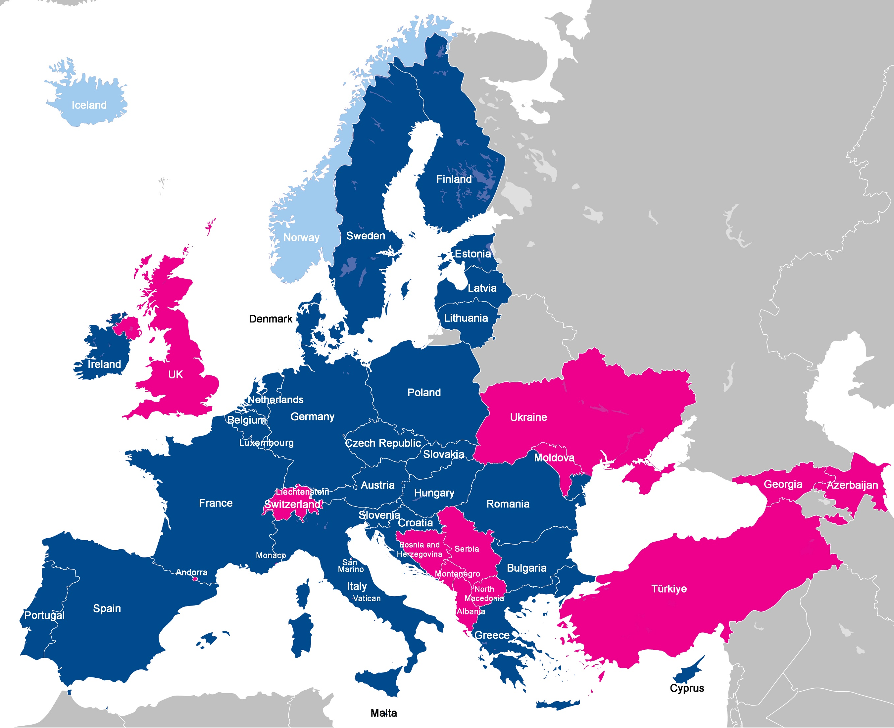
The map:
46 countries of the CEPT
27 are in the European Union
3 in the EEA

Slide 3

ETSI NSOs and NSBs
GREECE: ELOT
HUNGARY: MSZT e
ICELAND: IST
IRELAND: NSAI
ITALY: CEI
ITALY: UNI
LATVIA: Latvian Standards
LITHUANIA: Lithuanian Standards Board
LUXEMBOURG: ILNAS
MALTA: MCCAA
MOLDOVA: ISM
MONTENEGRO: ISME
NETHERLANDS: NEN
NORTH MACEDONIA: ISRSM
NORWAY: Nkom
POLAND: PKN
PORTUGAL: IPQ
ROMANIA: ASRO
SERBIA: ISS
SLOVAKIA: UNMS SR
SLOVENIA: SIST
SPAIN: UNE
SWEDEN: ITS
SWITZERLAND: asut
UKRAINE: SE UkrNDNC
UNITED KINGDOM: BSI
= Both NSO and NSB status
ALBANIA: DPS
AUSTRIA: ASI
AUSTRIA: OVE
BELGIUM: NBN
BOSNIA & HERZEGOVINA: ISBIH
BULGARIA: CRC
CROATIA: HZN
CYPRUS: CYS
CZECH REPUBLIC: UNMZ
DENMARK: Dansk Standards
ESTONIA: CPTRA
FINLAND: TRAFICOM
FRANCE: AFNOR
GEORGIA: GeoSTM
GERMANY: DKE

Slide 4
Why does Europe need standards
Promote Consistency Across Europe: Standards ensure uniformity in policies, regulations, and practices, fostering unity across Europe's diverse nations.
Facilitate Trade and Economic Integration: Common standards reduce trade barriers, enabling businesses to operate seamlessly across borders and boosting the single market.
Augment Consumer Protection: Standards guarantee that products and services meet quality, safety, and environmental criteria, building trust and safeguarding citizens.
Support Innovation and Technology: Harmonised standards provide a framework for emerging technologies and industries, enabling faster adoption and development.
Address Global Challenges: Unified standards allow Europe to tackle pressing issues such as climate change, cybersecurity, and public health on both regional and global scales.
Improve Regulatory Efficiency: Standardisation streamlines processes, reducing redundancy and administrative burdens.
Enhance Interoperability: Standards enable systems, devices, and services to work together efficiently, ensuring compatibility across borders and sectors.
Boost Opportunities for SMEs: By providing clear frameworks, standards help smaller businesses compete in the European and global markets.
Strengthen International Influence: Promoting European standards globally helps shape international norms and enhances Europe’s geopolitical standing.

Slide 5
The European Union and the CEPT
The European Union is made up of the 27 Member states
The CEPT includes the Administrations of 46 member countries
ETSI works with National Standards Organisations from 39 countries of which 29 are members of the EU/EEA (National Standardisation Bodies)
  – Austria and Italy have two NSBs
There are 2 processes to create European Standards (EN)
  ENAP – Initiated by ETSI members
  SRdAP – Initiated by a Standardisation Request (SReq) from the European Commission

Slide 6
ETSI as an ESO
ETSI Statutes: Article 2:
  “As a recognised European Standards Organisation, an important task within the overall objective shall be to produce and perform the maintenance of the technical standards which are necessary to achieve a large unified European market for telecommunications, ICT, other electronic communications networks and services and related areas.”
Regulation (EU) No 1025/2012
  Legal framework established by the European Parliament and Council to govern European standardisation
  Ensures transparency, inclusivity, and stakeholder participation in the standardisation process.

Slide 7

Adoption processes:
ENAP vs SRdAP
ENAP (EN Approval Process) applies to ENs elaborated in response to proposals from ETSI members
SRdAP (Standardisation Request deliverables Approval Process) applies to ENs (and European standardisation deliverables) elaborated in response to EC/EFTA Standardisation Requests
28 calendar days
Notes:
This slide shows the graphic approval process when (1) an EN is produced under EN Approval Process also called ENAP (see the top line)
and when (2) an EN is produced under SRdAP (see the bottom line).
We clearly see that an EN requested by an EU/EFTA Standardisation Request shown on the bottom line, has a first step called Standardisation Request Acceptance which is under the NSB’s responsibility, this is not the case for an EN requested by members (shown on top line) .
Nevertheless, the deliverable adoption process is quite similar. This will be detailed in the following slides.
During the drafting by the European Commission of a new Standardisation Request,
it is expected that the European Commission consults and involves ETSI in this process to comment and/or propose modifications to the working draft Standardisation Request text.
ETSI will involve its relevant technical groups, NSBs, NSOs, Annex III organizations, Board and OCG.
However, it is the sole responsibility of the eligible NSBs to accept or reject the submitted standardization requests and to adopt, change or stop the work items.

Slide 8
Improving inclusiveness
ETSI is a member-based organisation – so only members can contribute to the technical committees
  NOTE that the ETSI membership includes SMEs, Micro-Enterprises and Universities (around 31% of membership)
ETSI is a very open standards body, allowing anyone to download published specifications for free, view the committee structure, explore the work plan, and even access the titles of contributions to the technical groups.
The EC has nominated certain organisations (Annexe III) to ensure that under-represented groups have a voice. They are represented up to Board level
  They represent specific societal interests in the European standardisation process. They ensure that the voices of various stakeholders are heard and considered during the development of European standards.
The NSBs and NSOs obtain feedback from all their national stakeholders including regional businesses, local universities, even consumer organisations.

Slide 9
Conclusions
ETSI develops European Standards (ENs) – to build a unified market across both the European Union and the CEPT
The ENAP process is used for the CEPT area
  The SRdAP process is used to support standardisation requests from the European Commission affecting only EEA countries
ETSI Technical Bodies draft and reach a consensus of technical experts drawn from Members in an open process
National Standards Organisations (NSO) and National Standardisation Bodies (NSB) scrutinise, comment and vote to adopt ENs based on feedback from national stakeholders. They also withdraw any conflicting National Standards
More detailed videos on these 2 processes are available on the LEARN area of the ETSI website: https://www.etsi.org/education/learn

Slide 10
Thank you

