Slide 1
Standards and Regulation in Europe
Part 2: CEPT
Date: April 2025

Slide 2
European Norms – An example
ETSI EN 303 645: Cyber Security for Consumer Internet of Things
2016 - cyber criminals compromised more than 300 000 products with the Mirai malware
2017 and 2018 - a range of vulnerabilities were identified in the web service that connected to a smart watch brand that is marketed at children
Vulnerability of baby monitors and domestic CCTV cameras to hacking, the UK National Cyber Security Centre issued a warning and guidance for consumers
October 2018 – UK voluntary Code of Practice for Consumer IoT Security with the 13 principles
The UK Government worked with ETSI to create a new globally applicable standard ETSI EN 303 645: Cyber Security for Consumer Internet of Things
June 2020 - ETSI EN 303 645 approved
UK Product Security and Telecommunications Infrastructure Act 2022 becomes a legal requirement
Similar legal requirements adopted across Europe

Slide 3

The ENAP Process
ENAP (EN Approval Process) applies to ENs elaborated in response to proposals from ETSI members
Notes:
This slide shows the graphic approval process when (1) an EN is produced under EN Approval Process also called ENAP (see the top line)
and when (2) an EN is produced under SRdAP (see the bottom line).
We clearly see that an EN requested by an EU/EFTA Standardisation Request shown on the bottom line, has a first step called Standardisation Request Acceptance which is under the NSB’s responsibility, this is not the case for an EN requested by members (shown on top line) .
Nevertheless, the deliverable adoption process is quite similar. This will be detailed in the following slides.
During the drafting by the European Commission of a new Standardisation Request,
it is expected that the European Commission consults and involves ETSI in this process to comment and/or propose modifications to the working draft Standardisation Request text.
ETSI will involve its relevant technical groups, NSBs, NSOs, Annex III organizations, Board and OCG.
However, it is the sole responsibility of the eligible NSBs to accept or reject the submitted standardization requests and to adopt, change or stop the work items.

Slide 4

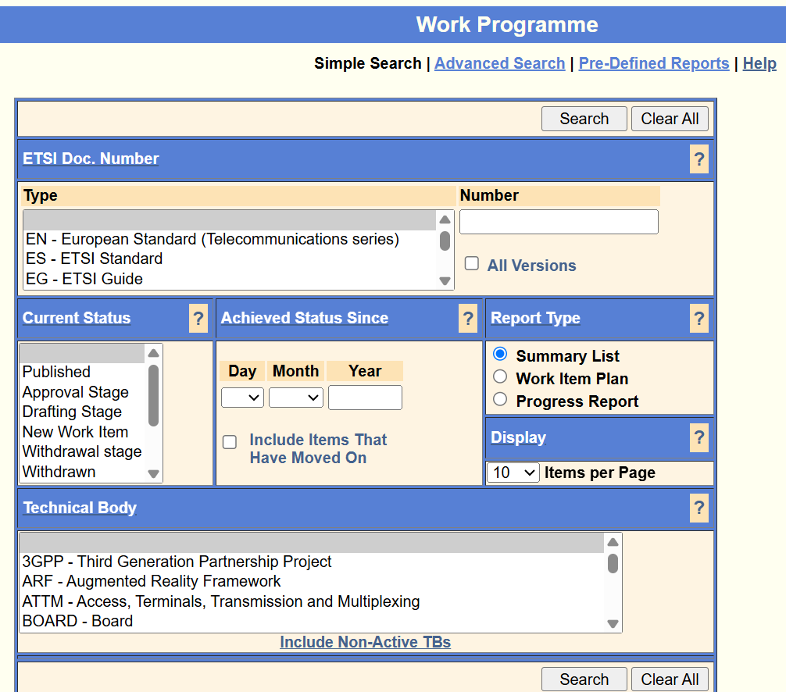
Starting work
Starting from a need to create an EN, ETSI starts a
Work Item
    Proposed by at least four supporting ETSI members
    New Work Item adopted by a decision of a Technical Body
Work items published in the ETSI Work Programme
    Publicly accessible from the ETSI portal
    Possibility for any member to object until the end of the
    following month
    Supports cooperation and limits the risk of overlap with
    other work in ETSI and CEN/CLC

Slide 5

ETSI Technical Bodies draft the EN
Contributions from ETSI Members
  NOTE: Not National delegations (particularity of ETSI)
Any interested ETSI Member may participate
Adoption by consensus is the dominant method
Voting (by members) is possible but very rarely used

Slide 6
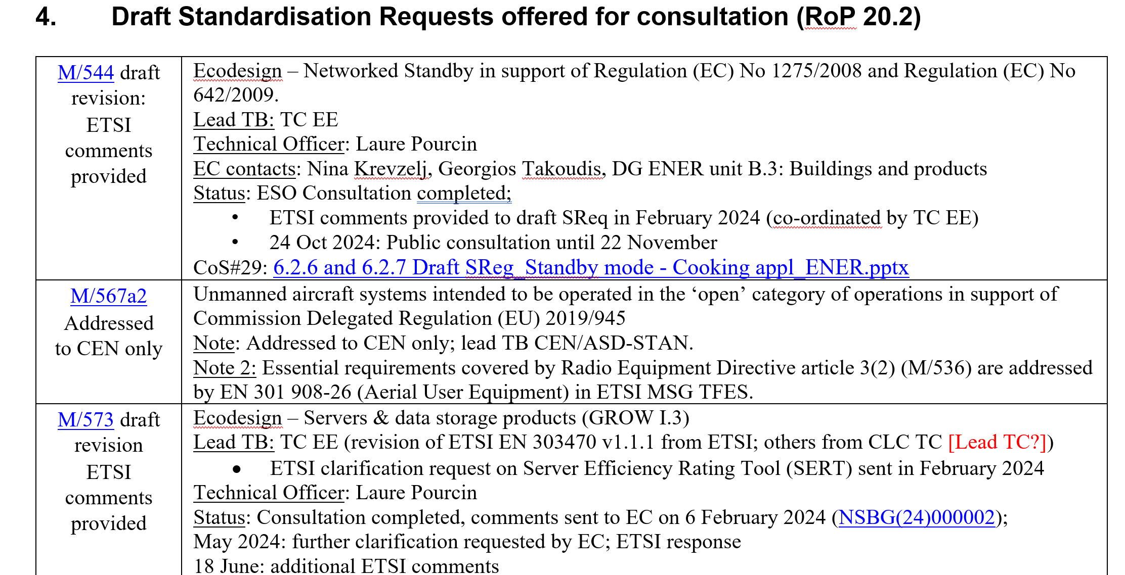
Concentrating efforts & avoiding National divergence
The adoption of an EN work item triggers Standstill (RoP 3.3)
National Standardisation Bodies (NSBs) and ETSI Members are required:
  to stop any national standards work that could prejudice that EN, and
  not to publish a new or revised standard which is not completely in line with an existing EN

Slide 7


National Standards Organisations (NSO) adopt and transpose the EN into National Standards
EN Approval Procedure (ENAP):
  NSOs scrutinise a draft EN which has been approved by an ETSI Technical Body, classify and consolidate National comments and establish a National position (yes/no)
  If any NSO provides a technical comment, the procedure is paused and the comments resolved before a weighted National Vote
  If 71% (weighted vote of NSOs are in favour), and the quorum of 50 % is reached, the EN is adopted
  NSOs transpose the EN at National level and commit to withdraw any conflicting National standards before an agreed date of withdrawal (dow)

Slide 8
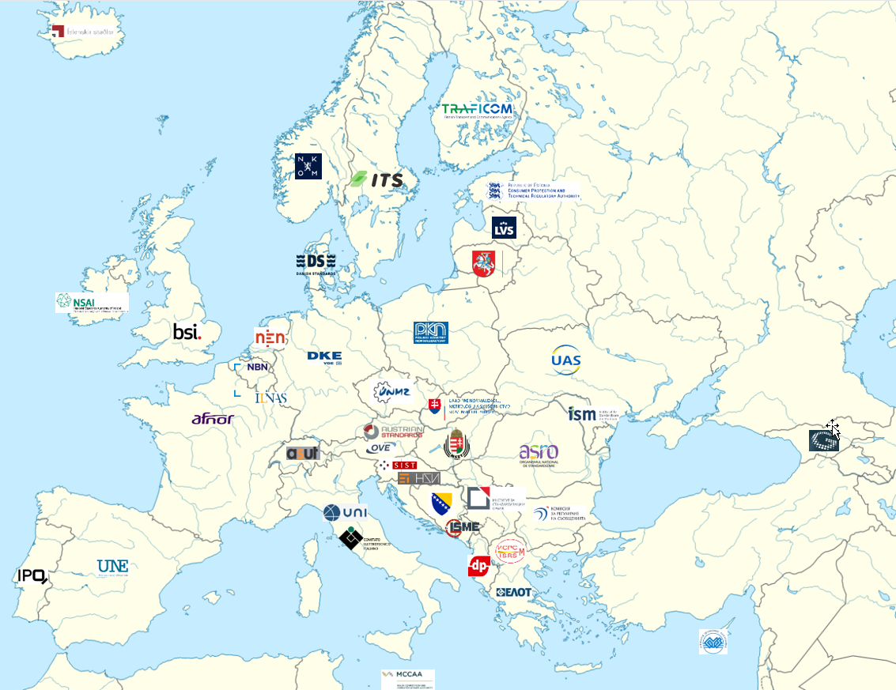
Who are the NSOs?
https://www.etsi.org/about/our-partnerships
ALBANIA: DPS
AUSTRIA: ASI and OVE
BELGIUM: NBN
BOSNIA & HERZEGOVINA: ISBIH
BULGARIA: CRC
CROATIA: HZN
CYPRUS: CYS
CZECH REPUBLIC: UNMZ
DENMARK: Dansk Standards
ESTONIA: CPTRA
FINLAND: TRAFICOM
FRANCE: AFNOR
GEORGIA: GeoSTM
GERMANY: DKE
GREECE: ELOT
HUNGARY: MSZT e
ICELAND: IST
IRELAND: NSAI
ITALY: CEI and UNI
LATVIA: Latvian Standards
LITHUANIA: Lithuanian Standards Board
LUXEMBOURG: ILNAS
MALTA: MCCAA
MOLDOVA: ISM
MONTENEGRO: ISME
NETHERLANDS: NEN
NORTH MACEDONIA: ISRSM
NORWAY: Nkom
POLAND: PKN
PORTUGAL: IPQ
ROMANIA: ASRO
SERBIA: ISS
SLOVAKIA: UNMS SR
SLOVENIA: SIST
SPAIN: UNE
SWEDEN: ITS
SWITZERLAND: asut
UKRAINE: SE UkrNDNC
UNITED KINGDOM: BSI
Notes:
This is a quick overview of all the ETSI NSOs.
The full details and links to each NSO are provided on the ETSI website.
For your information, most of the ETSI NSOs are also CEN/CENELEC National Bodies.

Slide 9
Conclusions
ETSI develops European Standards (ENs) using the ENAP process – to build a unified market across Europe
Technical Bodies draft and reach a consensus of technical experts drawn from Members in an open and transparent process
National Standards Organisations (NSO) from CEPT countries scrutinise, comment and vote to adopt ENs based on feedback from National stakeholders
The ENs are transposed into National Standards
Any conflicting National Standards are withdrawn by an agreed date

Slide 10
Thank you

