Slide 1
An Introduction to ETSI Industry Specification Groups (ISGs)

Slide 2
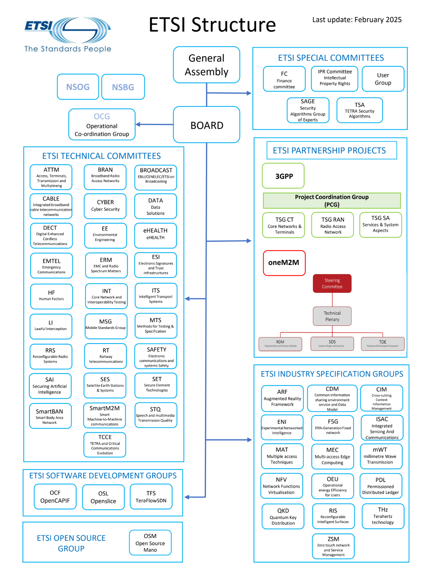
ETSI’s Technical Groups
1 Technical Coordination Group ​
  OCG​
27 Technical Committees​
  ATTM, BRAN, CABLE, CYBER, DATA, DECT, EE, eHealth, EMTEL, ERM, ESI, HF, INT, ITS, LI, MSG, MTS, RRS, RT, SAFETY, SAI, SES, SET, SmartBAN, SmartM2M, STQ, TCCE​
1 Joint Technical Committee​
  BROADCAST (Joint EBU/CENELEC/ETSI Technical Committee)​
5 Special Committees / groups​
  SAGE, USER, TSA​, Finance, IPR
2 ETSI Partnership projects​
  3GPP, oneM2M​
16 ISGs​
ARF, CDM, CIM, ENI, F5G, ISAC, MAT, MEC, mWT, NFV, OEU, PDL, QKD, RIS, THz, ZSM ​
4 SDGs​
  OCF, OSL, TFS, OSM

Slide 3
Technical Committee (TC)
Participation is governed by ETSI Technical Working Procedures (Directives)​
  All SDO have a set of rules – always worth reading if you ever get sent to a meeting​
Minimum 4 founding ETSI members​
All ETSI members can access all documents of all the Technical Groups​
Only ETSI members can join the meetings (very occasional the chair may invite a guest)
Only ETSI members can make contributions

Slide 4
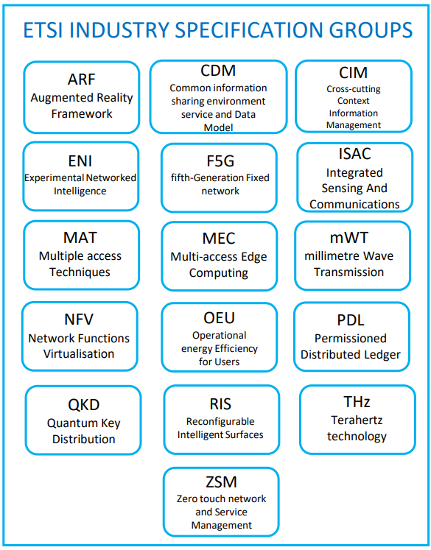
ETSI’s Industry Specification Groups
Concept created in 2008
ETSI members can join and become ISG members
Non-ETSI members can join as ISG Participants
  Participant Agreement imposes the ETSI IPR Policy​
Participants pay to join meetings
If Participants later join ETSI they can get up to 2 years of meeting fees off their first years ETSI membership

Slide 5
Industry Specification Group (ISG)
A special type of ETSI technical group, very focused activity, designed for quick establishment​
Fast to set up (minimum 4 founding ETSI members)​
Approved by the Director-General in consultation with the Board
Can modify some rules vs. TC, e.g. voting: some ISGs use 1 member = 1 vote​
Participation is governed by an Industry Specification Group Agreement​
  Sets out the operation rules, budget mechanism, voting rules, etc.​
ISG Participants can access ONLY the relevant ISG documents​
Can create Group Reports (GR) and/or Group Specifications (GS)

Slide 6
Move to website and portal demo

Slide 7
Thanks for watching

