Slide 1
The Basics Course
Presented by: Prof. Howard Benn

Slide 2
Contents
6 Modules
  Module 1 - What are standards, and why are they important?
  Module 2 - SDOs (in both Europe and globally). What are they?
  Module 3 - Introduction to ETSI.
  Module 4 - How standards are written
  Module 5 - An example of a standard.
  Module 6 - 3GPP and the Gs.

Slide 3
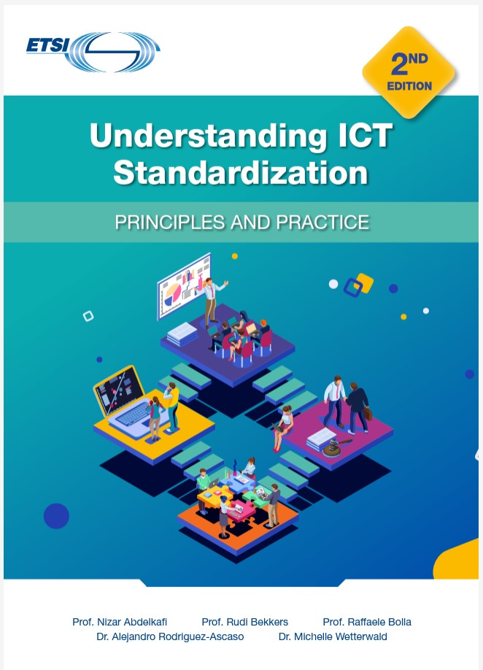
Accompanying textbook
Understanding ICT Standardization: Principles and Practice
(Published 2021)
    Includes supporting material, e.g. quizzes to prove knowledge
    More detailed information about the topics
    Available at: https://www.etsi.org/education

