Slide 1
Research & Innovation in ETSI

Slide 2
Why does ETSI help researchers to create standards?
ETSI standards are driven by technology innovation and research
Many standards contributors started as researchers in Universities, helped by collaborative EC funded research programs
We want a competitive European industry (large, medium and small enterprises) – ultimately generating wealth (and wellbeing) for European citizens / institutes.
Standardisation is a major competitive advantage.
Enterprises / EC funded projects / academia should be encouraged, guided and helped to engage in standardization at the appropriate moment.

Slide 3
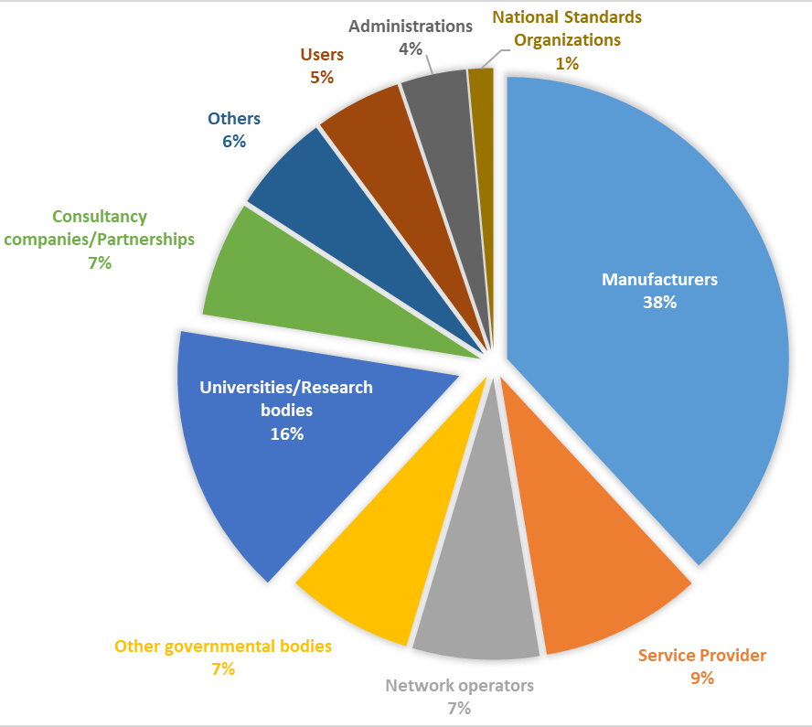

ETSI community of researchers, academics and innovators
ETSI currently has over 900 members from 63 countries over 5 continents
Public / Private Research organizations and Universities make up 16 % of our ETSI membership and are present both in Europe and globally
Through a single membership, all university representatives and postgraduate researchers may have access to the technical work of ETSI
All ETSI members have equal rights of direct participation in the standards-making activities and related services
Being a research and innovation member of ETSI, will put you in good company.
Membership fee of €2 100* per calendar year,
it’s a great deal for universities and public research bodies

Slide 4


Barriers to Remove for Researchers
Free access to all standards
Open and transparent process
Extensive training material
ISGs welcome non-members
Access to world leading expertise
Technology roadmaps
See who is contributing

Slide 5
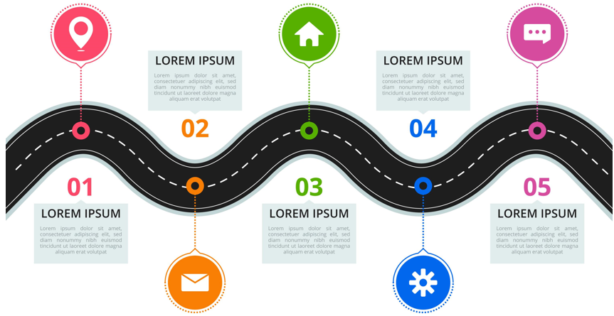




From Research to Market
Public / Private Research
EU / National Projects
Early PoCs & Demos
Detailed Standards
Normative Standards
Interoperability Tests
Technology Research
Standards
Technology Directions
Pre-Standards
Market
Policy Directions
Market Directions
Technology Directions
Investigative Standards
Informative Frameworks
Early PoCs & Demos
Global Products
Global / Local Services
Profits

Slide 6
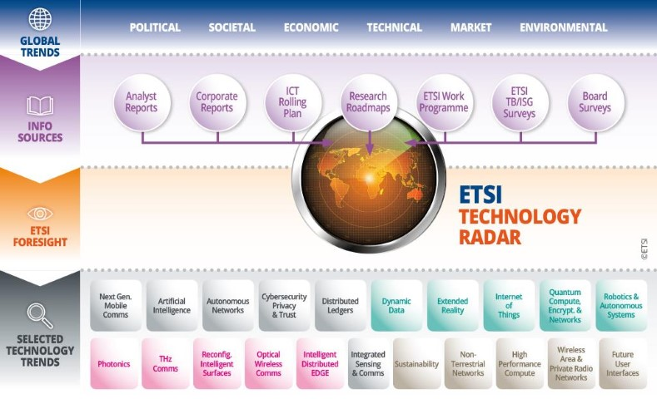
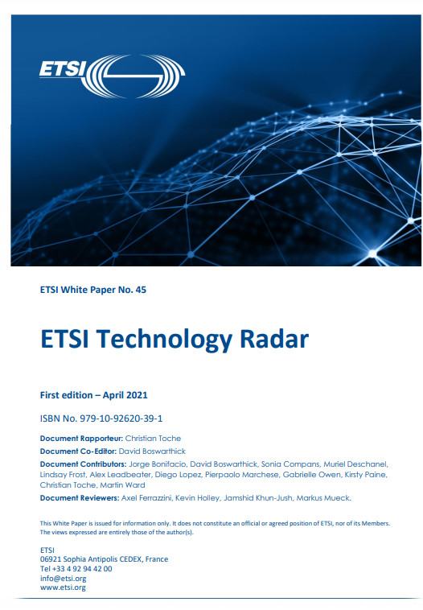

ETSI Technology Radar -> Foresight
  ETSI Technology Radar (ETR) tracks the major technology trends that are just over the horizon .
  Latest ETR describes 21 technology trends & identifies opportunities for new ETSI work areas.
  Your feedback on the ETR is welcome.
ETSI
ISG
ETSI
ISG
ETSI
ISG
ETSI Technology Radar: https://www.etsi.org/technologies/technology-radar

Slide 7

Support for technology research
Enable New Work in ETSI
ETSI TECHNO. RADAR
Links to RESEARCH
  ETSI encourages a constant flow of research & innovation into our standards work.
  Enablers for Research and Innovation.
  Build strong links between researchers, innovators, projects & standardization
    Working with EU platforms
    (such as Horizon Europe, SNS JU, 6G-IA, NetworldEurope)
    Working with national / EU / global research platforms &
    projects (e.g. HEXA-X / Next G Alliance / one6G / IOWN)
  Support for EU and national research projects
    Letter of Support (LoS) to project consortia making proposals for both EC and National projects If project 1) is related to ETSI’s scope 2) contains at least 2 ETSI members and 3) considers ETSI standards as input and/or output
    Members of ETSI staff and representatives of ETSI Technical Committees may be present on EXTERNAL Advisory Committees of projects where we have a LoS. With remote participation at no charge.

Slide 8
ETSI Support to Projects and Researchers
Letter of Support to Projects
ETSI presence on Advisory Committees
Mapping of research to ETSI working groups
General Advice on Standardization
We are here to help. Contact research@etsi.org
8

Slide 9
ETSI Tools for Pre-standardization (ISGs and SDGs)
ETSI Industry Specification Groups (ISGs)
A pre-normative incubator for Research
ETSI Software Development Groups (SDGs)
A toolbox for Research and Standardization
ETSI ISGs are the perfect tool for developing ‘early’ standardization work resulting from research projects / other sources of innovation.
This tool has been used for many successful standards efforts on technologies such as mWT, NFV, Edge, Artificial Intelligence, AR/VR/XR, Quantum Safe, Quantum Key and many more.
Any group of at least four ETSI members can a request to the ETSI Director-General the creation of new ISGs in ETSI as long the relevant criteria are met.
Streamlined ISG process enables deliverables (GSs and GRs) to be published in matter of months, an ideal mechanism for early stage (pre)standardization.
ETSI ISGs are open to both ETSI members and non-members.
New ISGs can be initiated by ETSI both members and non-members, potentially opening up new domains / areas of work for ETSI.
Researchers and academics can take up official positions (Chair / Vice-Chair), become rapporteurs for ETSI deliverables and actively drive the current and future standards work of ETSI.
ETSI SDGs are the perfect tool for developing ‘early’ implementation work resulting from research projects / other sources of innovation.
This tool has been designed for collaborative software development at ETSI based on the successful experience with Open Source MANO and TeraFlowSDN.
SDGs allow for early experimentation, prototyping, validation and testing of concepts defined by ETSI Technical Groups and provide them with early and regular feedback. It’s an ideal mechanism for optimizing the quality of standards and reducing their time to market
Any group of at least four ETSI members, can request to the ETSI Director-General the creation of new SDG in ETSI, as long the relevant are criteria are met.
Various licence types are allowed, including Open Source
ETSI SDGs are open to ETSI members, non-members and individuals.
Researchers and academics can take up official positions (Chair / Vice-Chair), apply for technical leadership positions (TSC, MDL), lead the alignment and feedback to ETSI Technical Groups, and take an active role in driving the current and future work of ETSI.
2 SDGs created in 2023: OpenSlice and OpenCAPIF

Slide 10
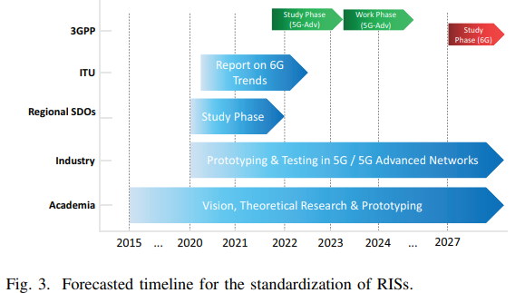

Example of research to pre-standards, new ISG RIS (Sept. 2021)
Provide an opportunity for ETSI members to collect their pre-standards research efforts on *RIS technology across various EU/UK collaborative projects, extended with relevant global initiatives, towards paving the way for future standardization of the RIS technology.
* RIS = Reconfigurable Intelligent Surfaces
Multi-domain Standards
Research #1
pre-Standards
Domain-specific Standards
e.g. 3GPP
Policy &
Strategy
Research #2
Research #3
Products to Market
Research #n
More information on https://www.etsi.org/committee/RIS

Slide 11
ETSI Resources for Researchers and Academics
Advice on ETSI Standards Activities
Dedicated research Webpages
Dedicated ETSI mentor for academics/researchers
Research guides / leaflets / videos
Support to researchers for EU Project proposals
Advice on EU research landscape
Help with setting up new standards groups
… and more
ETSI Research webpages:
www.etsi.org/research
https://www.linkedin.com/showcase/etsi-standardization-research-innovation-education
ETSI Research Helpdesk:
research@etsi.org

Slide 12

THANK YOU
FOR YOUR ATTENTION
Follow us on:

