Slide 1
Module 2 – SDOs – What are they?

Slide 2










SDOs - Standards Development Organizations
Support for standards creation via a collaborative process
Publishing and distribution of standards
Clear rules allow competitors to work together
Some sell the standards their members create
Vary in size and complexity

Slide 3
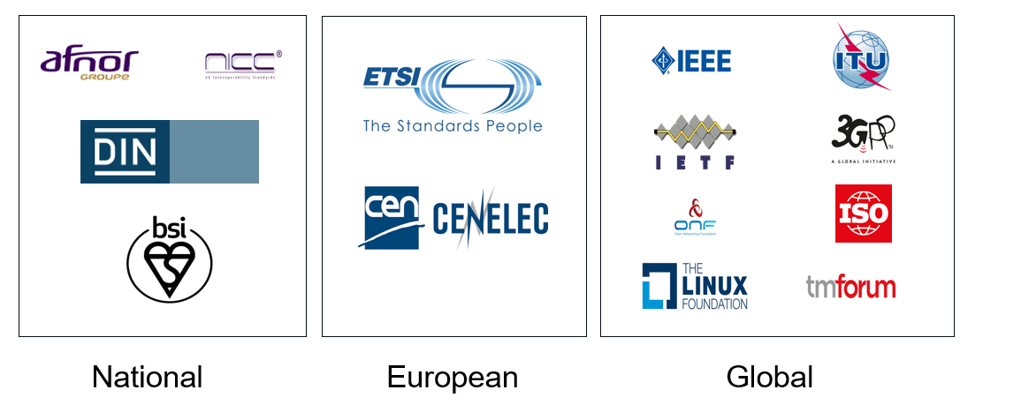
National, Regional, and Global Bodies
Regulation (EU) No 1025/2012 of the European Parliament and of the Council:
    Designates CEN, CENELEC and ETSI as the European Standardization Organizations (ESOs).

Slide 4
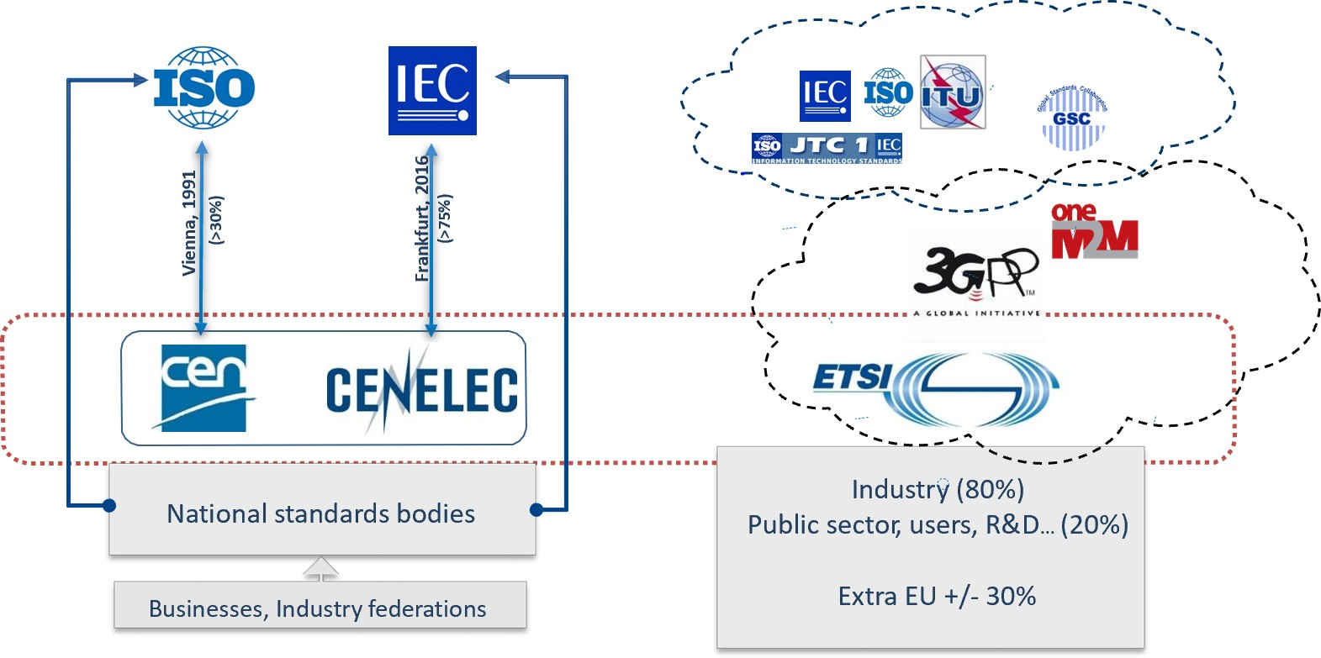
3 ESOs – making up the European Standardization System (ESS)

Slide 5
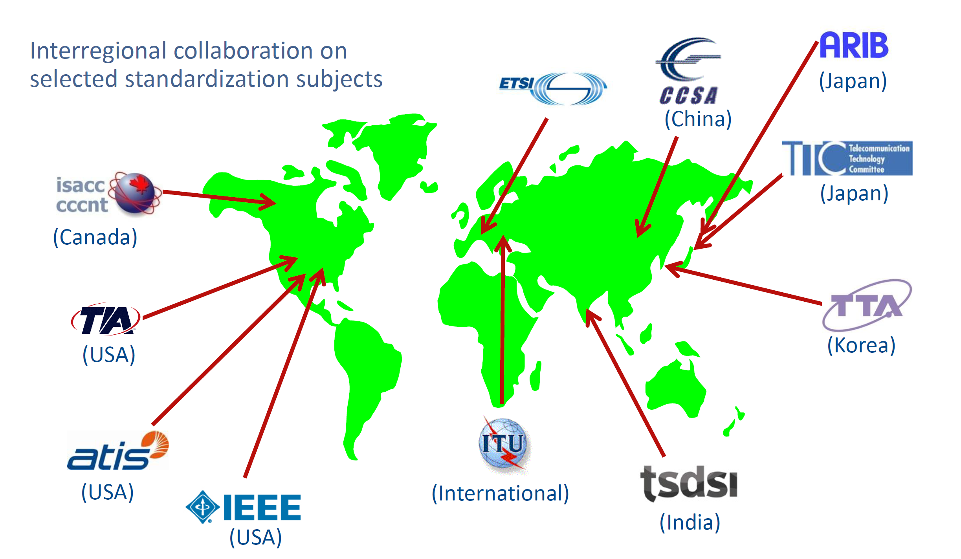
Regional SDOs in the world of Telecoms

Slide 6









Industrial Consortia
In addition to SDOs, there are other organizations that do not strictly or entirely use formal standardization procedures but aim at defining standards in a specific area
  Example Industrial Fora/Consortia: they are composed of groups of companies that temporarily join their efforts on specific subjects to realise, accelerate, complement, or promote the development of standards

Slide 7
De facto standards
We all use them – for example
  PDF: a document format created by Adobe Systems.
  HTML: a language for describing the structure of Web pages. It was originally created by Tim Berners-Lee, and it is currently published and maintained by W3C.
  Microsoft Windows: an operating system that became an industry standard, and so did its specifications (e.g., the Microsoft Web Services Security specification, WS-Security).
They are called “de facto standards”. They are common practices adopted by the market, which are not the result of any formal standardization process.
De facto standards may be adopted as formal standards by recognised SDOs:
  ISO/IEC 15445:2000 Information technology -- Document description and processing languages -- HyperText Markup Language (HTML).
  ISO 32000-1:2008 Document management -- Portable document format -- Part 1: PDF.

Slide 8


Partnership projects – bringing SDOs together
SDOs can create groups/projects for cooperating in the definition of specific standards
  3GPP
    The standards that ensure your mobile works
  OneM2M
    interoperability of Machine-to-Machine (M2M) communications and the Internet of Things (IoT).
  Partnership projects are creating global standards, hence the reason your phone works everywhere, but don’t forget to pack the power adapter when you go on holiday!

Slide 9
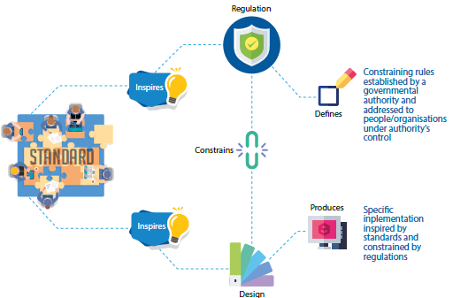
Formal standardization, SDO standards, and regulation
Standards are NOT regulations.
Standards are NOT a set of thorough design rules.
Standards are voluntary,
NOT compulsory
But some regulations reference standards
Some regulators ask for standards- e.g. the EC with standardization requests

Slide 10

Summary
Standards development organizations enable
the creation and maintenance of standards
Experts write the standards
They come from industry, academia, governmental bodies….
Most SDOs have some form of membership
Go find your national one
Search for standards on something you are interested in, and see who the SDO is
https://webapp.etsi.org/Teddi/ - what is that acronym

Slide 11

Thank you for your attention
Follow us on:

