Slide 1
Module 4 – How are standards written?

Slide 2

Why do Standards Development Organizations have rules?
Different SDO have different ways to create and approve standards
All have common themes:
  transparency
  openness
  consensus
  stakeholder engagement
  relevance to market needs
  impartiality
  effectiveness
  balance
  coherence

Slide 3

Who writes them?
Domain experts from industry, SMEs, academia, governmental bodies, users…
Standards is not really a career, but a path to making your work count
You get to work with world-leading experts
Potential to make a real difference to society
Increasing online meeting attendance, but in-person still works best
Technical experts who can contribute to writing standards tend to be paid better than those who do not

Slide 4

ETSI standardization workflow
ETSI Work Item - description of a standardization task approved by a Technical Group according to the relevant procedures and adopted by the ETSI members
  intended deliverable type (EN, ES, TS, EG, TR, SR)
  technical scope
  schedule of tasks for its production
  supporting members (minimum 4)
  TBs/ISGs/OSGs define and approve new Work Items.
  ETSI Deliverable - A document produced as the result of an ETSI work item

Slide 5

ETSI Standardization workflow
Normative Documents
TS - ETSI Technical Specification
  Short time to market, may be converted later to ES or EN – approved by the Technical group
ES - ETSI Standard
  Entire ETSI membership approves
EN - European Standard
  Formal output for Standardization at European level
  Specific to Europe & needs transposition into national standards or required by an EC/EFTA mandate
  Harmonised Standards are a subset of ENs

Slide 6

ETSI Standardization workflow
Informative Documents
TR - ETSI Technical Report
  Default deliverable when containing only informative elements - approved by the Technical group
EG - ETSI Guide
  Guidance on handling technical Standardization activity in whole or major parts of the Technical Organization
ETSI Special Report
  General ETSI member or public interest
  Also, deliverable with dynamic content generated by a software application on the ETSI web site on the basis of database content.

Slide 7

Building Consensus
All SDOs try to approve the content of standards by consensus
  Definition: A general agreement, characterised by the absence of sustained opposition to substantial issues by any important part of the concerned interest and by a process that involves seeking to take into account the views of all parties concerned and to reconcile any conflicting arguments.
  Note: Consensus need not imply unanimity.
This can be the hardest part for the delegates involved in the drafting and approval of a document.
Voting can be used as a last resort – extremely rare.

Slide 8

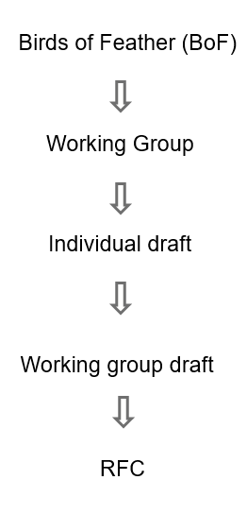
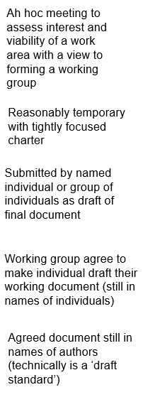
IETF
Origins are academic funded by US defence
Now fully independent body
Global body with US based administration
Membership is by individual expert
Agreement is by consensus and ‘mood of the room’
‘Rough consensus and running code’

Slide 9


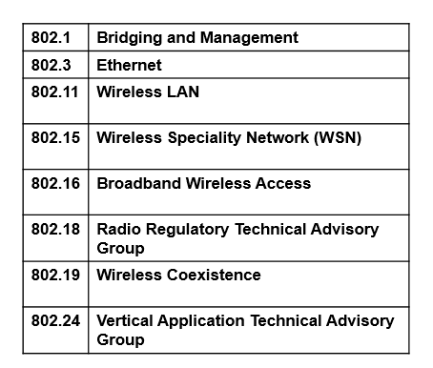
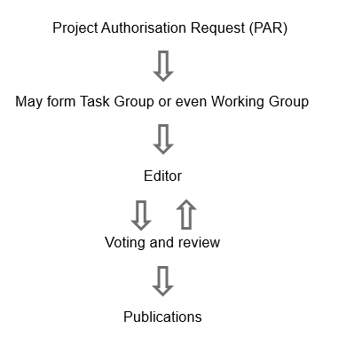
IEEE802
PAR is tightly focused and strongly reviewed before agreement

Slide 10
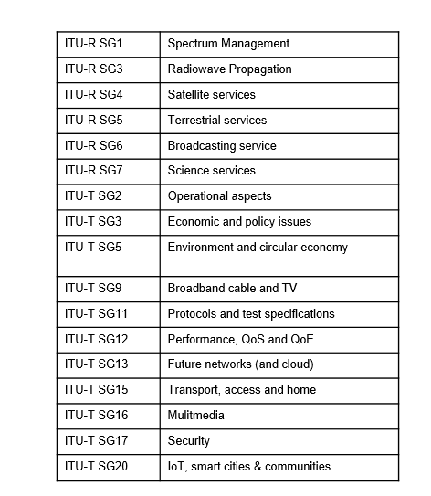
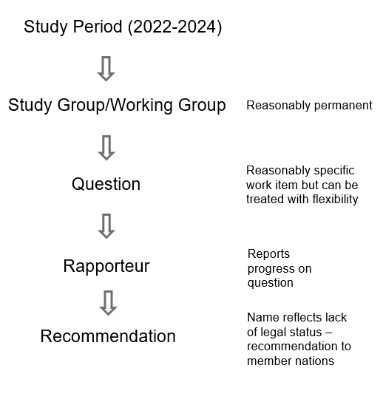
ITU

Slide 11

Summary
Standards organizations have rules and processes
All organizations will help you if you ever end up in a meeting, and your competitors become you friends (well maybe after the meeting ends)
Of all the skill you will need “consensus” is the hardest – think going out with your friends and choosing a restaurant
Go find one of the standards games to practice consensus building, they work well with pizza and beer

Slide 12

Thank you for your attention
Follow us on:

