Slide 1

Standards in Public and Defence Procurements
EU Legislation
Nikolaos Myriounis
DEFSTAND PC Scientific Advisor
nikolaos_myriounis@defstand.com

Slide 2

Standards and EU Legislation
A harmonised standard is a European standard;
  Developed by a recognized European Standardization Organization: CEN, CENELEC or ETSI
  It is created following a request from the European Commission to these organizations
  The references of harmonised standards published in the Official Journal of the European Union to give “Presumption of Conformity”
Harmonised standards provide Presumption of Conformity = Harmonised standards can be used to demonstrate that products, services, or processes comply with relevant EU legislation

Slide 3

Standards and EU Legislation
You can use non-harmonized standards to conform to regulations however non-harmonized standards do not automatically comply with the essential requirements of the Directives.
Technical requirements given in EU legislation are mandatory, while the use of (harmonized) standards is usually voluntary.

Slide 4

Types of Legislation in the EU
Regulations
Directives
Decisions
Recommendations
Opinions

Slide 5
EU Directives
A Directive is a legislative act that sets out a goal that all EU countries must achieve.
However, it is up to the individual countries to devise their own laws on how to reach these goals.
    Example: While all Radio Equipment sold in the EU must meet the essential requirements defined in the RED*, each member state has its own set of rules and penalties for how to ensure compliance. When a product falls under the scope of this Directive, it is therefore important to consider the relevant national legislation as well as the Directive itself.
* Directive 2014/53/EU (Radio Equipment Directive)

Slide 6


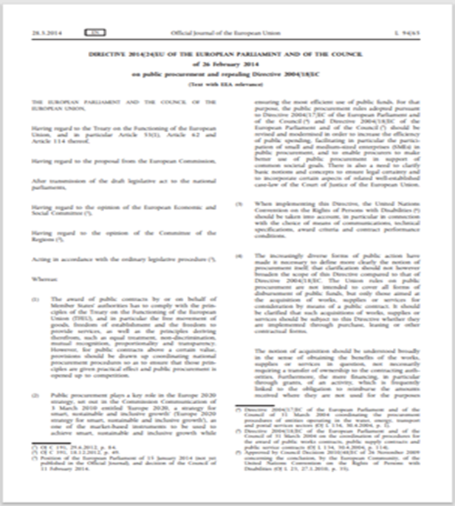
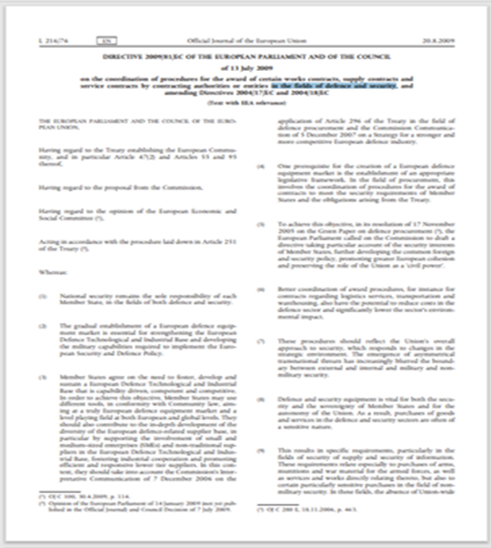
EU Directives for Public and Defence Procurements
Similar Aims
  The technical specifications [..] shall be set out in the contract documentation
  Technical specifications shall afford equal access for tenderers and shall not have the effect of creating unjustified obstacles to the opening up of procurement to competition

Slide 7
EU Directive 2009/81/EC
Priorities when referring to standards - Article 18
Without prejudice to compulsory national technical rules (including those related to product safety), or the technical requirements that Member States must meet under international standardization agreements to guarantee the interoperability required by those agreements, and provided they are compatible with Community law, technical specifications shall be drawn up, in the following order of preference:
    1. National civil standards transposing European standards
    2. European technical approvals
    3. Common civil technical specifications
    4. National civil standards transposing international standards
    5. Other international civil standards
    6. Other technical reference systems established by the European standardisation bodies, or, where these do not exist, other national civil standards, national technical approvals or national technical specifications relating to the design, calculation and execution of the works and use of the products,
    7. Civil technical specifications stemming from industry and widely recognised by it, or,
    8. National ‘defence standards’ [..] and defence material specifications similar to those standards.
Every reference shall be followed by the expression ‘or equivalent’

Slide 8
EU Standard applicable for 2009/81/EC
– EN 16341:2012
ΕΝ 16341 “Selection of standards and standard-like documents for defence products and services – Order of preference”*
Scope
This European Standard applies to the provision, development, use, improvement and disposal of defence products and services in accordance with Chapter II of Directive 2009/81/EC
It also applies to measures intended to maintain the operational readiness of products
This document supports project managers in the selection and use of applicable standards and standard-like documents
* European Standard developed by the European Committee for Standardization (CEN).

Slide 9
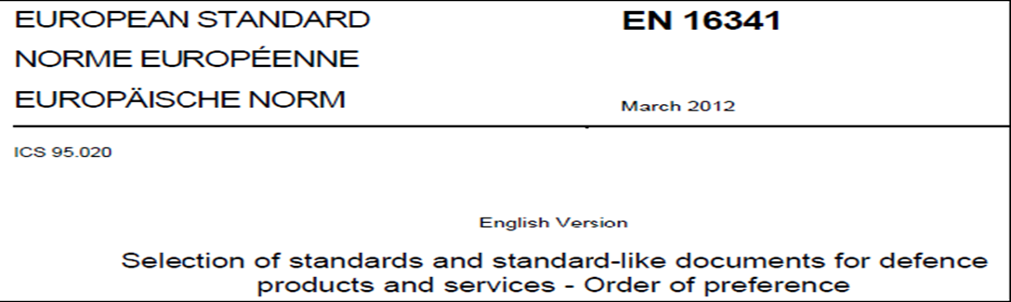
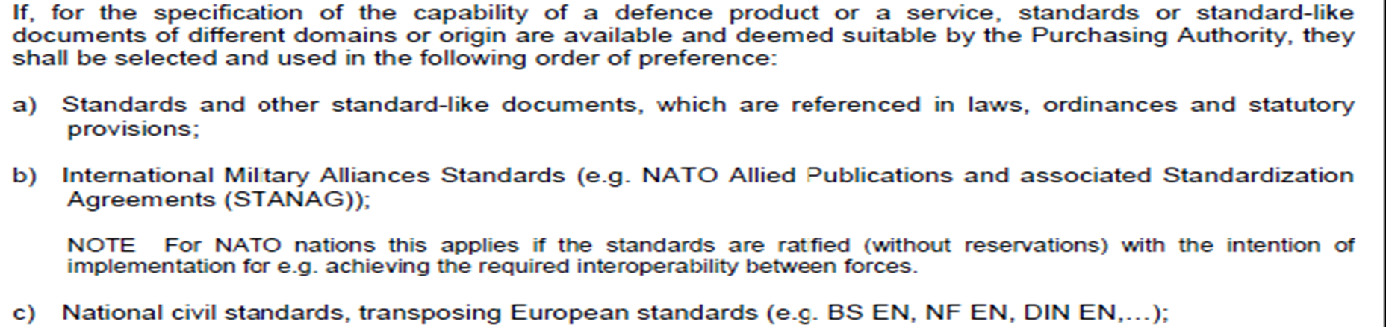
EN 16341:2012
Order of preference
Each reference in tendering documents shall be followed by the expression "or equivalent" as stated in Directive 2009/81/EC.

Slide 10
Takeaways
2009/81/EC is the driving EU Legislation for Defence and Security Procurements.
Article 18 of 2009/81/EC addresses provisions for referring standards in technical specifications for Defence and Security procurements.
The definitions in the directives or in standards are valid for that document and can defined in different ways in other documents.
EN 16341 supports project managers in the selection and use of applicable standards and standard-like documents in defence and security procurements.
Estimates of product cost savings following a more intensive use of civil standards in defence procurements range from 10 % to 50 %.

Slide 11
THANK YOU
FOR YOUR ATTENTION
Nikolaos Myriounis
DEFSTAND PC Scientific Advisor
nikolaos_myriounis@defstand.com

